Slide 1
TJAGLCS Training Package
Legal Aspects of Cyber Operations
March 2025

Slide 2
The information provided throughout this training aid does not, and is not intended to, constitute legal advice; instead, all information, laws, statues, content, and materials for this training aid are for general informational purposes only. This training aid may not constitute the most up-to-date legal or other relevant legal information. Judge Advocates need to conduct their own due diligence through independent further legal research on any specific legal issue contained in this training package. No reader, user, or trainee of this product should act or refrain from acting based on information from this training aid without first seeking legal advice from an attorney in the relevant jurisdiction.

Slide 3
Legal Aspects of Cyber Operations

Slide 4
What is Cyberspace?
“The interdependent network of information technology infrastructures and resident data, including the Internet, telecommunications networks, computer systems, and embedded processors and controllers.”
DoD General Counsel Remarks at U.S. CYBERCOM Legal Conference, 2020
“A global domain within the information environment consisting of interdependent networks of information technology infrastructures and resident data, including the Internet, telecommunications networks, computer systems, and embedded processors and controllers.”
JP 3-12, Cyberspace Operations

Slide 5
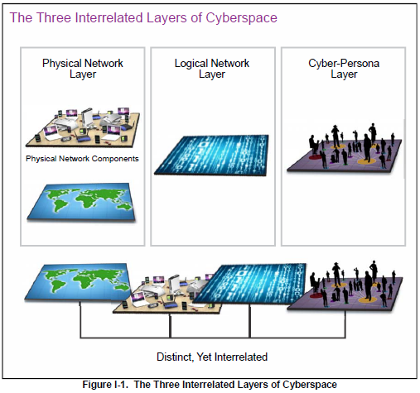

Slide 6
The Spectrum of DOD Cyber Operations
DODIN
DCO-IDM (CPTs)
DCO-RA (NMTs)
OCO
Inside DOD Network
Defensive operations in which authorized defense actions occur within the defended portion of cyberspace.
Defensive operations that are taken external to the defended network without or without the permission of the owner of the affected system.
Outside DOD Network
Network focused
E.g., Anti-Virus Software / Network construction
E.g., Seeking/Removing Insider Threat
Specific Threat
E.g., Shutting down enemy network prior to attack
Domestic Law
Domestic / I-Law / LOAC
Contract/Banners
Domestic / I-Law
E.g., Stopping an attack before it happens
Within the DoD network
Notes:
DCO-IDM: Internal Defensive Measures
CPT: Cyber Protection Teams
DCO-RA: Responsive Actions
NMT: National Mission Teams
DODIN Operations. The DODIN operations mission includes operational actions taken to secure, configure, operate, extend, maintain, and sustain DOD cyberspace and to create and preserve the confidentiality, availability, and integrity of the DODIN.
DCO. DCO missions are executed to defend the DODIN, or other cyberspace DOD cyberspace forces have been ordered to defend, from active threats in cyberspace.
OCO. OCO are CO missions intended to project power in and through foreign cyberspace through actions taken in support of CCDR or national objectives.

Slide 7
General Legal Review Framework (OCOs)
Legal Review
U.S. Domestic Law
International Law
National and Agency (DoD) Policies and Directives
Notes:
In all legal reviews for OCOs, there are three elements that are included: US Domestic Law, International law, and Policy

Slide 8
U.S. Domestic Law
Properly authorized? (Law, Policies)
Any statutes or policies restricting the operation?
Privacy and civil liberties concerns?
Notes:
When we ask if something is properly authorized, we are asking whether congress and/or the president has authorized us to do this thing. What title 10 authority is there to conduct this operation. Are there are domestic statutes that may limit the operation, or how we are seeking to execute the operation? And finally, do we have any constitutional concerns (1st or 4th amendment) ?

Slide 9
International Law Considerations
Sovereignty
State Responsibility
Neutrality
International Humanitarian Law (both jus ad bellum and jus in bello)
Human rights law
Notes:
From an international law perspective, many tenants of public international law apply to aspects of offensive cyber operations.

Slide 10
Policies and Directives
National/Agency Policies/Directives
State Positions

Slide 11
Need Training Materials?
Have Training Materials?
Questions?
Contact Us!
TJAGLCS-training@army.mil

